Slide 1
Client-side vs. Server-side JavaScript
Presentation by Your Name
July - 2024

Slide 2

Client-side JavaScript
Front-End Functionality
Enhanced User Interaction
It primarily focuses on front-end functionality, such as DOM manipulation, event handling, and client-side validation. This approach speeds up responsiveness, reduces server load, and provides a smoother user experience.
By leveraging client-side JavaScript, web developers can create interactive interfaces, real-time updates, and dynamic content loading, resulting in engaging and user-friendly web applications.
Role in Web Development
Client-side JavaScript is executed on the user's browser, allowing for dynamic interaction with web pages by enhancing user experience. It enables features like form validation, interactive content, and dynamic page behavior without requiring server interaction.

Slide 3

Server-side JavaScript
Server-Side Processing
Advanced Web Functionality
It deals with server-side processing, business logic implementation, data validation, and database operations. Server-side JavaScript manages the server infrastructure and performs operations that require server resources.
Incorporating server-side JavaScript enhances web functionality by enabling server communications, data processing, and running server-specific tasks. It is crucial for application scalability, security, and managing server resources efficiently.
Significance in Web Applications
Server-side JavaScript executes on the server, handling tasks like database operations, authentication, and server requests. It powers the back-end logic of web applications, ensuring data management, security, and server-side rendering.

Slide 4
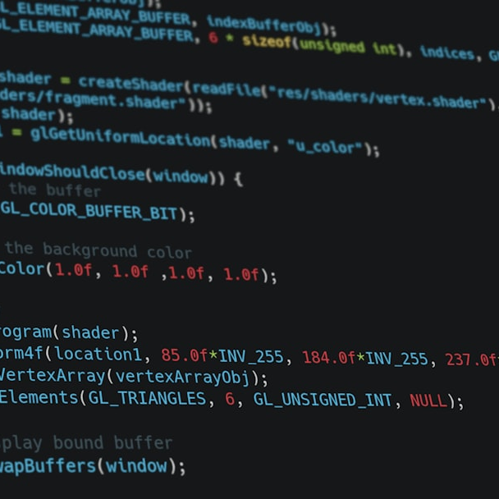
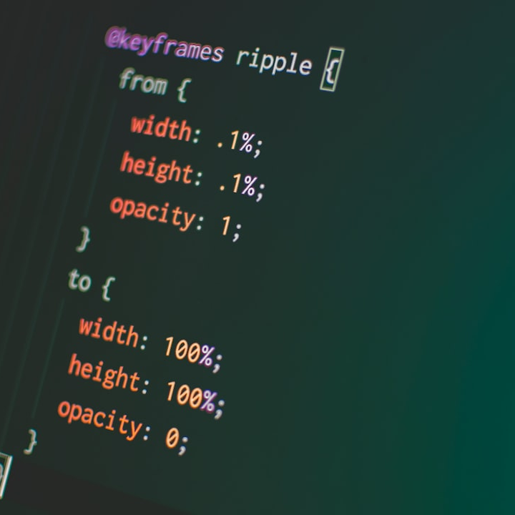
Differences in Execution
Server-side JavaScript
Executes on the web server, managing backend operations, processing data, and interacting with databases. Server-side code runs on the server, enabling secure data handling, server communication, and server-specific tasks.
Client-side JavaScript
Executes on the user's browser, enhancing client-side interactions, providing instant feedback, and reducing server requests. It runs on the client's device, implementing front-end logic and user interface enhancements.

Slide 5

Interactions with Web Elements
Server-side JavaScript
Indirectly interacts with web elements, handling server-side operations like data processing, form submissions, and authentication. It focuses on server tasks and backend operations rather than direct web element manipulation.
Client-side JavaScript
Interacts directly with web elements on the user's browser, enabling dynamic content updates, form validations, and user interface enhancements in real-time. It manipulates the Document Object Model (DOM) to create interactive web experiences.

Slide 6

Pros and Cons
Client-side JavaScript
Advantages include enhanced user experience, reduced server load, and faster response times. However, it can expose vulnerabilities, increase complexity, and rely on client resources.
Server-side JavaScript
Offers secure data handling, server processing capabilities, and scalable architecture. Yet, it requires server resources, may have slower response times, and could lead to server-side vulnerabilities.

Slide 7
Case Studies
Application Type | JavaScript Implementation
Social Media Platform | Client-side for real-time updates, server-side for data management
E-commerce Website | Client-side for dynamic user experience, server-side for secure transactions
Project Management Tool | Client-side for interactive features, server-side for task management

